Slide 1
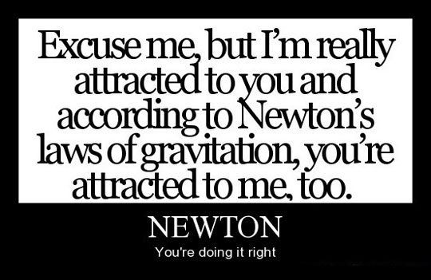
It’s science.

Slide 2
Newton’s Law of Universal Gravitation
Nan Lan and Claire LaRosa
Monday, 2/17/14

Slide 3
Newton
Background
Math
Philosophy

Slide 4
Background
Theologian
Heretic to church - Unitarianism
Convinced Trinitarianism was product of conspiracy
Responsible for first posing question of critical bible hermeneutics

Slide 5
Background
Lucasian Chair of Mathematics 1669-1701
http://www.youtube.com/watch?v=nEa7CfPaCRw
Notes:
Play video until 1:25 ****INTRO

Slide 6
Everyone’s favorite misconception
Notes:
What textbooks think: Newton considered rate at which moon must “fall” toward E to remain in circular orbit, asked what Ac needed to produce this motion; concluded Ac from E at x(moon) decreased as inverse square of x from center of E compared to known value of G at surface. then bold generalization → law of universal grav. FALSE.

Slide 7
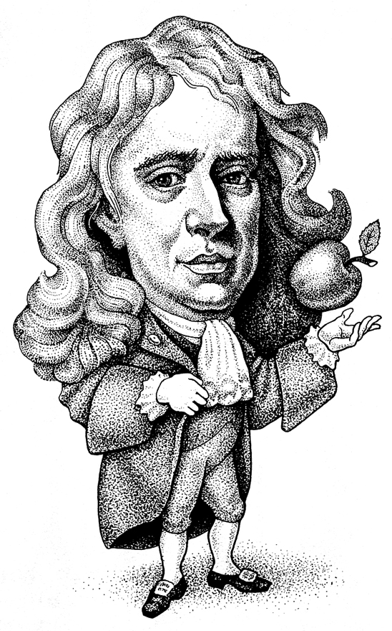
…Misconception? Say what?
Didn’t use scientific method!
Many fragmented discoveries + Math → Science!
Bonus: Reasoned calculus into existence
Transition to “modern physical science”
“If I have seen further, it has been by standing on the shoulders of giants.”
Notes:
Universal Law of Gravitation as transition to “modern physical science”
1660s, science = puzzle.

Slide 8
A Brief Timeline
Kepler’s 2nd and 3rd Laws
1609
Descartes’ Law of Inertia
1650
Newton’s
Principia
1687
1640
Galileo’s Laws of Motion
1670
Inverse-Square Law
Notes:
Kepler: ellipses. Driven by ‘spokes’ of force radiating from sun Galileo: circles. Circular motion self-perpetuating. Descartes: Bodies persist in straight-line motion. PLanets held on curved trajectories by an all-pervading comic aether. Newton: took fragmented mess -----> laws. ALSO: applied earthly laws to planets, like Galileo’s insight that understanding why objects fell to eath would help him understand what kept the moon in orbit

Slide 9
Newton
Background
Math
Philosophy

Slide 10
The math: inverse square force
Newton’s Second Law:
Geometry:
Kepler’s Third Law:
Notes:
Ac = v^2/r from circle = polygon of infinite sides

Slide 11
The Cavendish Experiment
Henry Cavendish (1731-1810) found the value of G
Nearly 100 years later!
http://www.youtube.com/watch?v=EE9TMwXnx-s

Slide 12
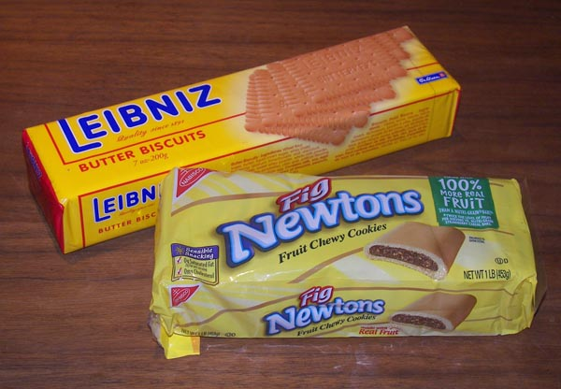
The math: did someone say calculus?

Slide 13
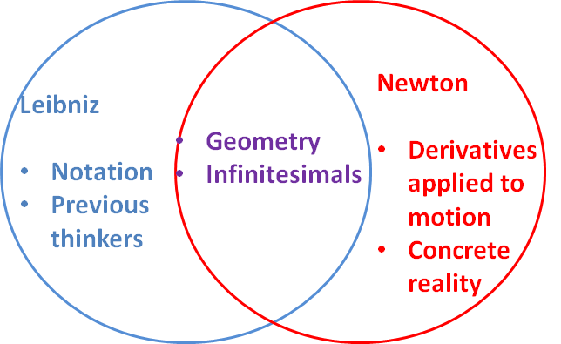
The math: calculus
Notes:
N: about 1666 started - Geometric proofs, concrete reality, NOT concepts/theory; calc from derviatives as applied to motion; published 1687 L: Notation (d for diff 1684, S for int 1686,); geometric approach from previous thinkers like Descartes, Pascal
Smear campaign to discredit Leibniz

Slide 14
The math: calculus
Inside a uniform spherical shell, a point mass experiences no net gravitational force
A point mass outside a uniform spherical shell will be attracted to the center of the sphere as if all its mass were concentrated at the center

Slide 15
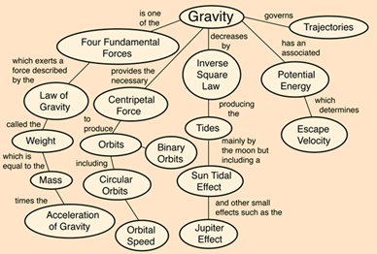
Importance
Notes:
From http://hyperphysics.phy-astr.gsu.edu/hbase/grav.html#grav

Slide 16
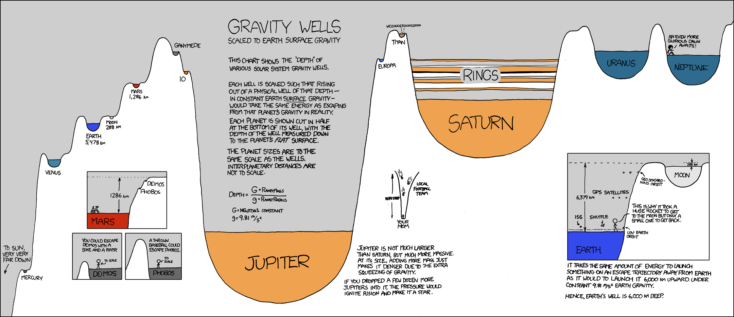
Gravity Wells
Notes:
xkcd.com
#681

Slide 17
Inertial and Gravitational Masses
A priori they really have nothing to do with each other…
Inertial mass: a measure of its resistance to acceleration when a given force is applied to it
Gravitational mass: the magnitude of the gravitational attraction between the body and any other body
Pendulum experiment

Slide 18
True source of gravity
Newton: close approximation
Modern thinking: Einstein’s general relativity
Gravitation is an attribute of curved spacetime, not a force propagated between bodies
Energy and momentum distort spacetime in their vicinity, and other particles move in trajectories determined by the geometry of spacetime
http://www.youtube.com/watch?v=yhG_ArxmwRM
Notes:
Video: 1:28 till the end

Slide 19
Newton
Background
Math
Philosophy

Slide 20
Philosophy - Cartesian thinking
Mind | Body
Sensation = untruth
Cogito, ergo sum
Mind, matter = finite; God = infinite
Uncertainty in science result of God’s omnipotence
We have idea of infinite God ∴ God must exist

Slide 21
Philosophy - Newton
Broad view: relation between any entity and space
Spatiality is an affection of every kind of being;
God exists necessarily, so
There is no time at which God fails to exist; and, therefore,
Space exists, and there is no time at which space fails to exist (Stein 2002; Janiak 2000, 221-27).

Slide 22
Philosophy - Newton
Ordinary motion: the action by which a body travels from one place to another
Proper motion: the transfer of one piece of matter, or one body, from the vicinity of the other bodies which immediately touch it, and which we consider to be at rest, to the vicinity of other bodies
→ The distinction = goal of physics (both Newtonian and Cartesian)

Slide 23
Philosophy - Newton
Newton: God could create material bodies, or more precisely, could create entities that would be indistinguishable from material bodies from our point of view.
Features of body follow from
Descartes: Principle of extension (property of matter, existing in >1 dimension)
Newton: Essential features of our conception of the body

